Slide 2
Objectives
Explain the concept of data and database
Describe the approaches to data management
Define a Database Management System (DBMS) and list its benefits
Explain the different database models
Define and explain RDBMS
Describe entities and tables and list the characteristics of tables
List the differences between a DBMS and an RDBMS

Slide 3
Database
A database:
is an organized collection of data such that its contents can be easily accessed, managed, and updated
may consist of one or more related data items called records.

Slide 4
Data Management
Data management deals with managing large amount of information, which involves:
the storage of information
the provision of mechanisms for the manipulation of information
providing safety of information stored under various circumstances
The two different approaches of managing data are as follows:
File-based systems
Database systems

Slide 5
File-based Systems
Data is stored in discrete files stored on a computer.
Files called tables because they looked like tables used in traditional file keeping.
Rows in the table were called records and columns were called fields. For example :
Files called tables because they looked like tables used in traditional file keeping.
First Name | Last Name | Address | Phone
Eric | David | ericd@eff.org | 213-456-0987
Selena | Sol | selena@eff.org | 987-765-4321
Jordan | Lim | nadroj@otherdomain.com | 222-3456-123

Slide 6
Disadvantages of File-based Systems
Data redundancy and inconsistency
Unanticipated queries
Data isolation
Concurrent access anomalies
Security problems
Integrity problems
Notes:
Anomaly: bất thường
Integrity: toàn vẹn
Unanticipated queries : truy vấn bất thường

Slide 7
Database Systems
Evolved in the late 1960s to address common issues in applications handling large volumes of data
Used to store data in an efficient and organized manner
At any point of time, data can be retrieved, added, and searched based on some criteria in these databases
Used to store data in an efficient and organized manner.
Notes:
Evolve : phát triển
Intensive: chuyên sâu, thiên về
Achieve: đạt được

Slide 8
Advantages of Database Systems
The amount of redundancy can be reduced
No more inconsistencies in data
The stored data can be shared
Standards can be set and followed
Data Integrity can be maintained
Security of data can be implemented

Slide 9
Database Management System (DBMS)
A DBMS is a collection of related records and a set of programs that enables the user to enter, store, and manage data.
Example :
Computerized library systems
Automated teller machines
Flight reservation systems
Computerized parts inventory systems
Notes:
Interrelate: tương tác với nhau.
Automated teller machine : máy rút tiền tự động

Slide 10
Benefits of DBMS
Data storage
Data definition
Data manipulation
Data security and integrity
Data recovery and concurrency
Performance optimization
Multi-user access control
Database access languages and Application Programming Interfaces (APIs)

Slide 11
Database Models
Databases can be differentiated based on functions and model of the data.
A data model describes a container for storing data, and the process of storing and retrieving data from that container.
The analysis and design of data models has been the basis of the evolution of databases.
A
Flat-file Data Model
Hierarchical Data Model
Network Data Model
Relational Data Model
Notes:
Evolution :sw phat trien

Slide 12
Flat-file Data Model
consists of only one table or file.
is used for simple databases.
can cause redundancy when data is repeated more than once.
is used for simple databases -
^{Roll Number} | ^{First Name} | ^{Last Name} | ^{Subject} | ^{Marks}
45 | Jones | Bill | Maths | 84
45 | Jones | Bill | Science | 75
50 | Mary | Mathew | Science | 80

Slide 13
Hierarchical Data Model [1/2]
Different records are inter-related through hierarchical or tree-like structures.
Relationships are thought of in terms of children and parents.
A parent record can have several children, but a child can have only one parent.
To find data stored in this model, the user needs to know the structure of the tree.
Windows Registry is an example.

Slide 14
Hierarchical Data Model [2/2]
The advantages
Data sharing becomes easier, and security is provided and enforced by a DBMS.
Data independence reduces the effort and costs in maintaining the program.
This model is very efficient when a database contains a large volume of data.
For example, in a bank's customer account system, each customer's account is subject to a number of transactions.

Slide 15
Network Data Model [1/3]
is similar to the Hierarchical Data Model.
stores data in sets, instead of the hierarchical tree format. This solves the problem of data redundancy.
allows a child to have more than one parent. Thus, the records are physically linked through linked-lists.
Raima Database Manager (RDM) Server by Raima Inc. is an example of a Network DBMS.
The network model shown in the following illustrates a series of one-to-many relationships

Slide 16
Network Data Model [2/3]
The components of the language used with network models:
Data Definition Language (DDL)
Used to create and remove database objects. It enables the database administrator to define the schema components.
Sub-schema DDL
Enables the database administrator to define the database components.
Data Manipulation Language (DML)
Used to insert, retrieve, and modify database information.
Data Control Language (DCL)
Used to administer permissions on the database objects.

Slide 17
Network Data Model [3/3]
The advantages :
Relationships are easier to implement in the network model than in the hierarchical model.
This model enforces database integrity.
This model achieves sufficient data independence.
The disadvantages:
The databases in this model are difficult to design.
The programmer has to be familiar with the internal structures to access the DB
This model is difficult to implement and maintain.
Computer programmers, rather than end users, utilize this model.

Slide 18
Relational Data Model [1/3]
The term 'Relation' is derived from the set theory of mathematics. In the Relational Model, there are no physical links
All data is maintained in the form of tables consisting of rows, columns. Data in two tables is related through common columns
Operators are provided for operating on rows in tables. This model represents the database as a collection of relations
A row is called a tuple, a column is an attribute, and the table is called a relation
The list of values applicable to a particular field is called domain
Several attributes can belong to the same domain.
The number of attributes of a relation is called degree of the relation
The number of tuples determine the cardinality of the relation.
Notes:
Cumbersome:cồng kềnh
Khi nhu cầu tt tăng trưởng + các apps & dbs ngày càng phức tạp hơn -> việc sử dụng, ql và tk csdl trở nên cồng kềnh.

Slide 19
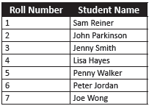
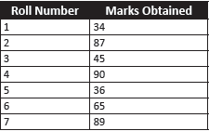
Relational Data Model [2/3]
In order to understand the relational model, consider the following Students and Marks tables:
To locate students with marks above 40:
First, locate the roll numbers of those who have scored above 50 from the Marks table.
Second, their names have to be located in the Students table by matching the roll number.
Students Table
Marks Table

Slide 20
Relational Data Model [3/3]
Advantages
Gives the programmer time to concentrate on the logical view of the database rather than being bothered about the physical view.
Provides querying flexibility .
Easy to the extent that even untrained people find it easy to generate handy reports and queries
Disadvantages
Hides all the complexities of the system and hence it tends to be slower than the other database systems.

Slide 21
Relational Database Management System (RDBMS)
An RDBMS is a software program that helps to create, maintain, and manipulate a relational database.
A relational database is divided into logical units called tables, where tables are related to one another within the database.
By having common keys, or fields, data from multiple tables can be joined to form one large resultset.
A relational database is divided into logical units called tables, where tables are related to one another within the database.
By having common keys, or fields, data from multiple tables can be joined to form one large resultset.

Slide 22
Terms Related to RDBMS [1/3]
Data is presented as a collection of relations.
Each relation is depicted as a table.
Columns are attributes.
Rows ('tuples') represent entities.
Every table has a set of attributes that are taken together as a 'key' (technically, a 'superkey'), which uniquely identifies each entity.

Slide 23
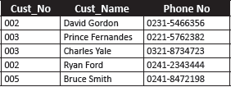
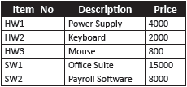
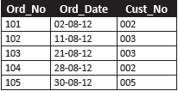
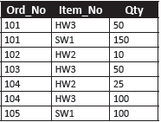
Terms Related to RDBMS [2/3]
Consider the scenario of a company maintaining customer and order information for products being sold and customer-order details for a specific month, say, August.
The following tables are used to illustrate this scenario:
Customer
Items
Order_August
Order_Details

Slide 24
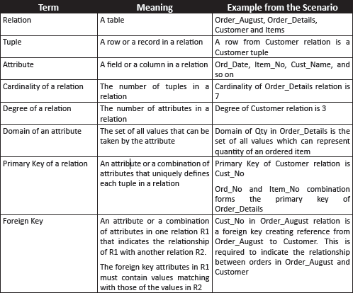
Terms Related to RDBMS [3/3]

Slide 25
Entity
An entity is a person, place, thing, object, event, or even a concept, which can be distinctly identified.
For example, the entities in a university are students, faculty members, and courses.
Each entity has certain characteristics known as attributes.
For example, the student entity might include attributes like student number, name, and grade.
A grouping of related entities becomes an entity set.
For example, the student entity might include attributes like student number, name, and grade.

Slide 26
Characteristics of a Table
A two-dimensional structure composed of rows and columns
Each row (tuple) represents a single entity within the entity set.
Each table must have a key known as primary key that uniquely identifies each row.
Each column has a specific range of values known as the attribute domain
All values in a column must conform to the same data format.
The order of the rows and columns is immaterial in a DBMS.

Slide 27
RDBMS Users [1/2]
Database Administrator (DBA)
Database Designer
Collects the information that will be stored in the DB
Responsible for identifying the data to be stored in the DB
Responsible for authorizing access to the database
Coordinating and monitoring its use
Acquiring software and hardware resources as needed
Accountable for problems such as breach of security or poor system response time
Choosing appropriate structures to represent and store data
Communicate with all prospective DB users, in order to understand their requirements
To come up with a design that meets the requirements
Notes:
Involve: tham gia
Accountable for, responsible for : chịu trách nhiệm
Breach of security: vi phạm an ninh

Slide 28
RDBMS Users [2/2]
Design and implement the DBMS modules and interfaces as a software package.
DBMS Designers and Implementers
Determine the requirements of end users
System Analysts and Application Programmers
invokes an application to interact with the system, or writes a query for easy retrieval, modification, or deletion of data.
End User
Develop specifications for pre-determined transactions that meet these requirements
Implement these specifications as programs
Test, debug, document, and maintain these pre-determined transactions
Design, development, and operation of the DBMS software and system environment

Slide 29
DBMS vs. RDBMS
^{DBMS} | ^{RDBMS}
It does not need to have data in tabular structure nor does it enforce tabular relationships between data items. | tabular structure is a must and table relationships are enforced by the system. These relationships enable the user to apply and manage business rules with minimal coding.
Small amount of data can be stored and retrieved. | can store and retrieve large amount of data.
is less secure than RDBMS. | is more secure than DBMS.
It is a single user system. | It is a multiuser system.
Most DBMSs do not support client/server architecture. | supports client/server architecture.
Entities are given more importance and there is no relation established among these entities. | Relation is more importance. Thus, the tables are dependent and the user can establish various integrity constraints on these tables so that the ultimate data used by the user remains correct.
Notes:
Ultimate data: /ˈʌltɪmət/ dữ liệu cuối cùng

Slide 30
Summary
A DB is a collection of related data stored in the form of a table.
A data model describes a container for storing data and the process of storing and retrieving data from that container.
A DBMS is a collection of programs that enables the user to store, modify, and extract information from a database.
A Relational Database Management System (RDBMS) is a suite of software programs for creating, maintaining, modifying, and manipulating a relational database.
A relational database is divided into logical units called tables. These logical units are interrelated to each other within the database.
The main components of an RDBMS are entities and tables.
In an RDBMS, a relation is given more importance, whereas, in case of a DBMS, entities are given more importance and there is no relation established among these entities.

